Slide 1
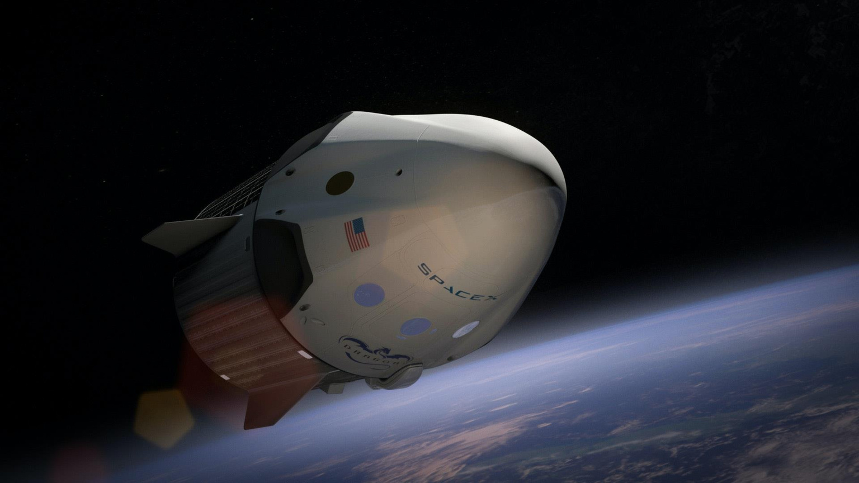
SpaceX Launch Analysis
By - Suman Bera

Slide 2
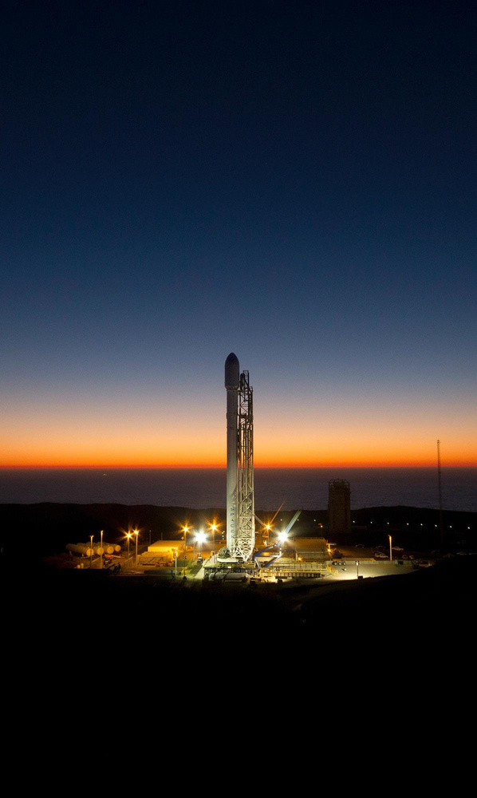

Index of Contents
P3 P4 P7 P9 P10
P11
Introduction Methodology
EDA with Visualization
Results
Dashboard
Conclusion
2

Slide 3
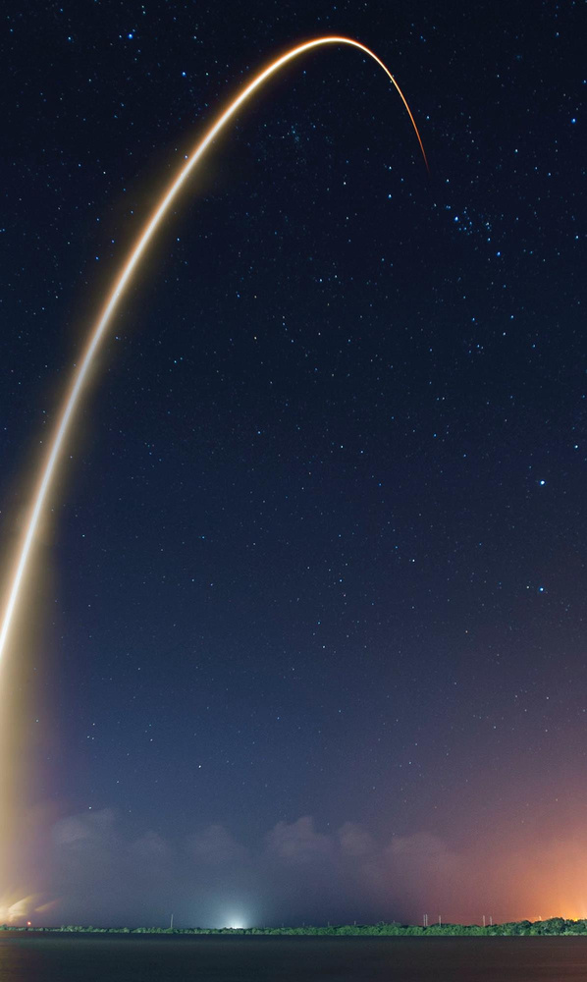
SpaceX is a trailblazer in the space industry, committed to making space exploration accessible and affordable. The company has achieved milestones such as:
Transporting spacecraft to the International Space Station (ISS)
Deploying a global satellite network for internet access
Successfully executing manned space missions
Key Advantage: Cost Efficiency SpaceX’s innovative reuse of the Falcon 9 rocket’s first stage drastically reduces launch costs to $62 million, compared to competitors charging over $165 million per launch.
Predicting Reusability with Machine Learning Leveraging public data and advanced machine learning, we can predict the reusability of the first stage—an essential factor in determining launch costs. This analysis extends to SpaceX and its competitors, shaping the future of cost-effective space travel.
Introduction
Explore
How payload mass, launch site, number of flights, and orbits affect first-stage.
Rate of successful landings over time.
4

Slide 4
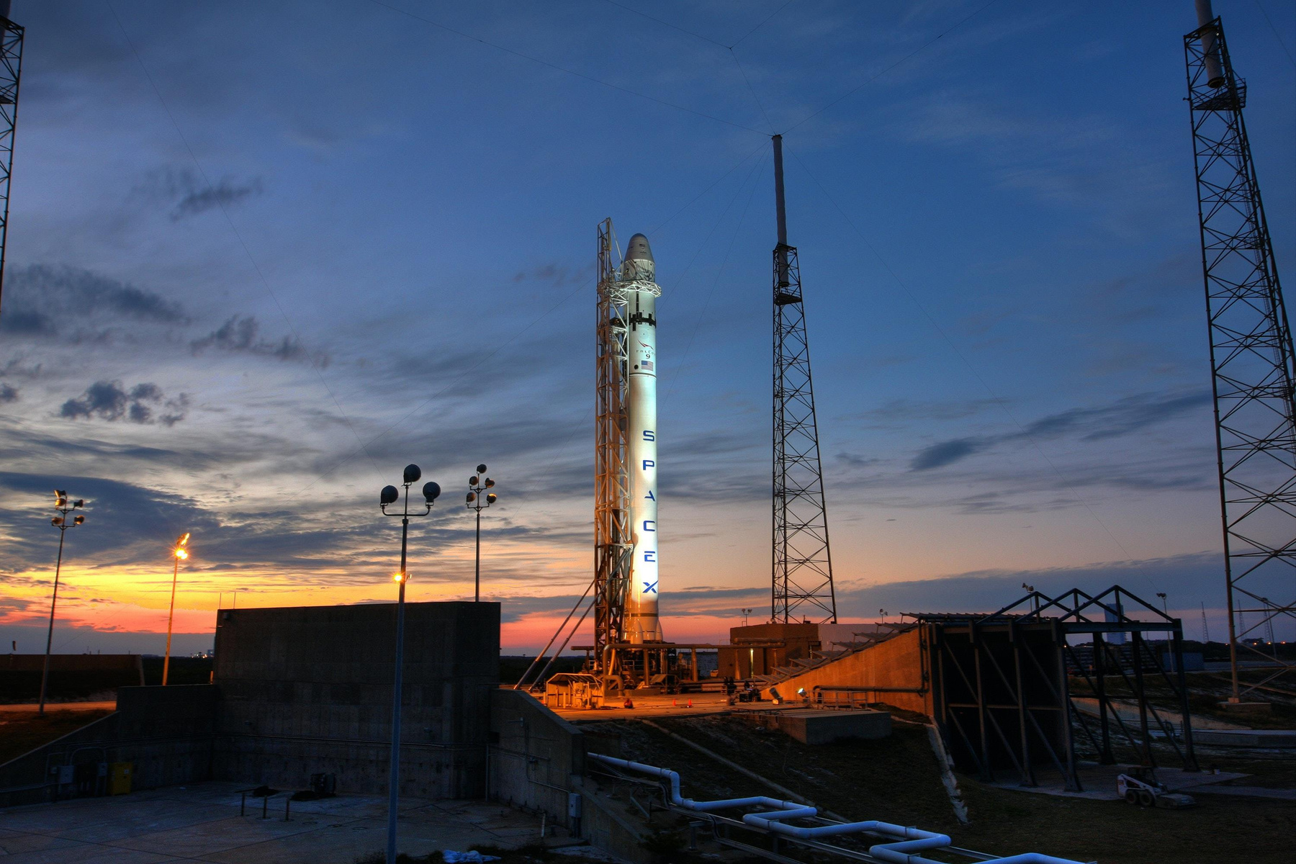
Methodology

Slide 5
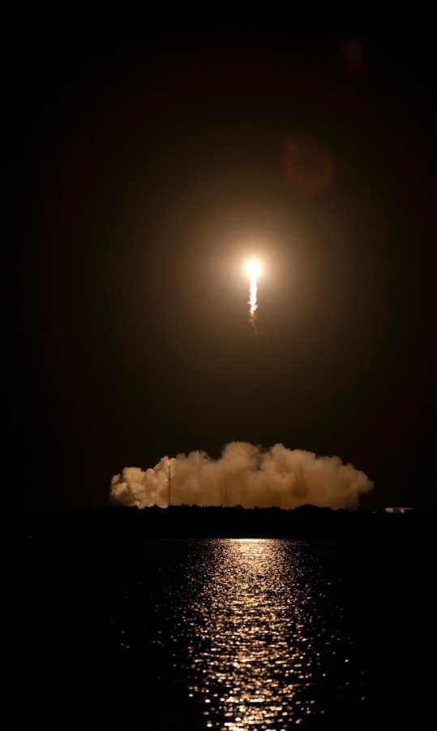
Methodology
Steps:
Collect data using SpaceX REST API and web scraping using Python.
Wrangle data –by filtering the data, handling missing values and applying one hot encoding –to prepare the data for analysis and modeling
Explore data via EDA and data visualization techniques
Visualize the data using Power BI Dashboard.
6

Slide 6
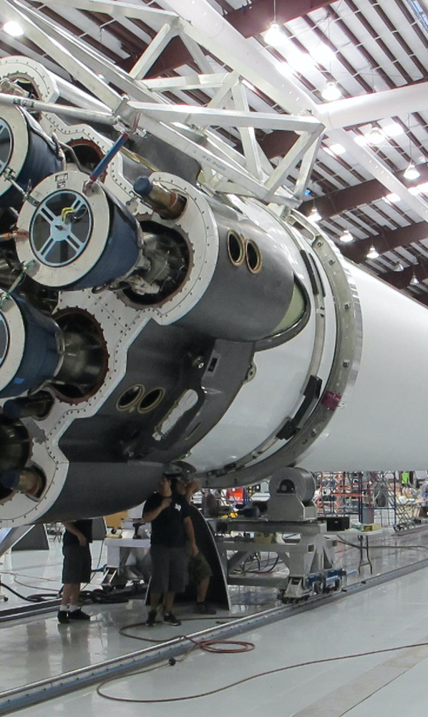
Data Collection –
Web Scraping
Steps:
Request data(Falcon 9 launch data) from Wikipedia
Create BeautifulSoup object from HTML response
Extract column names from HTML table header
Collect data from parsing HTML tables
Create dictionary from the data
Create dataframe from the dictionary
Export data to csv file
8

Slide 7
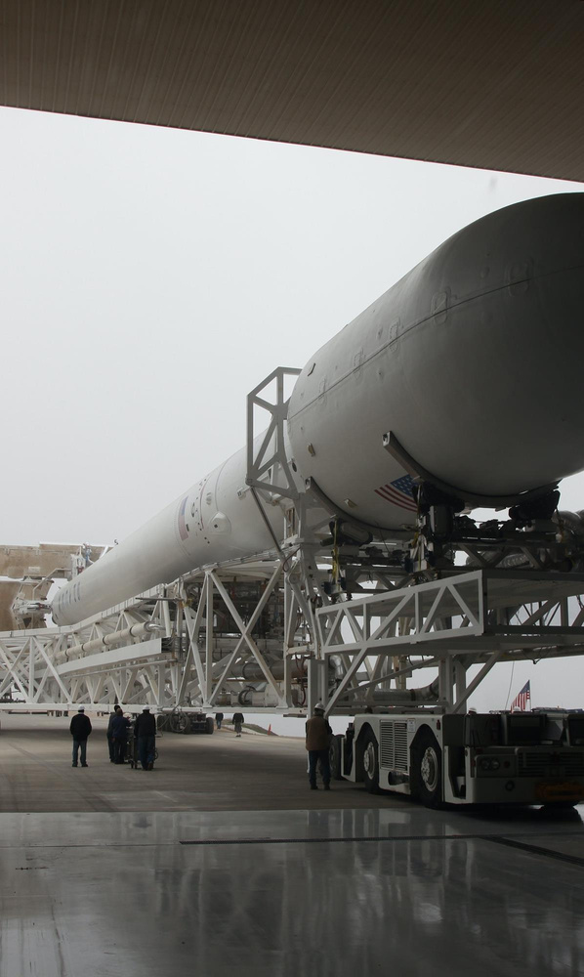
EDA with Visualization
Charts:
Flight Number vs. Payload
Flight Number vs. Launch Site
Payload Mass (kg) vs. Launch Site
Payload Mass (kg) vs. Orbit type
Analysis:
•View relationship by using scatter plots. The variables could be useful for
machine learning if a relationship exists
•Show comparisons among discrete categories with bar charts. Bar charts
show the relationships among the categories and a measured value.
2023
10

Slide 8
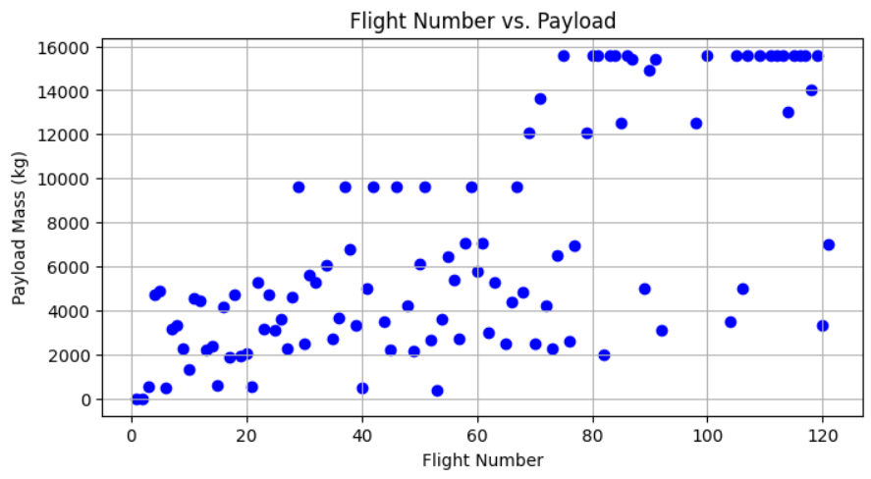
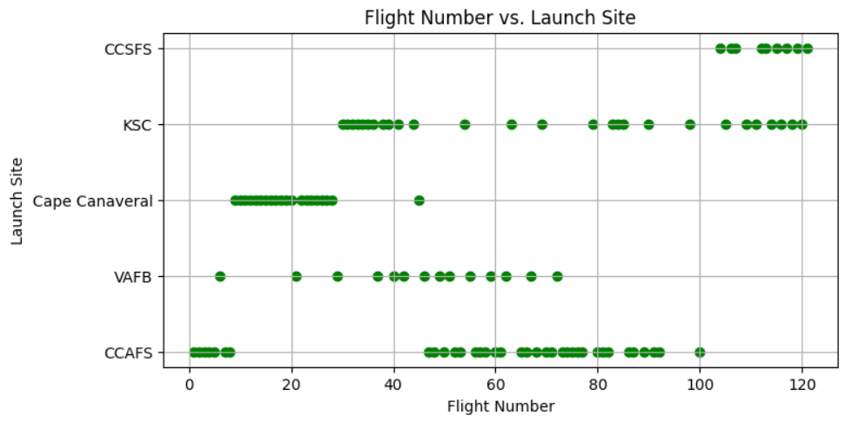
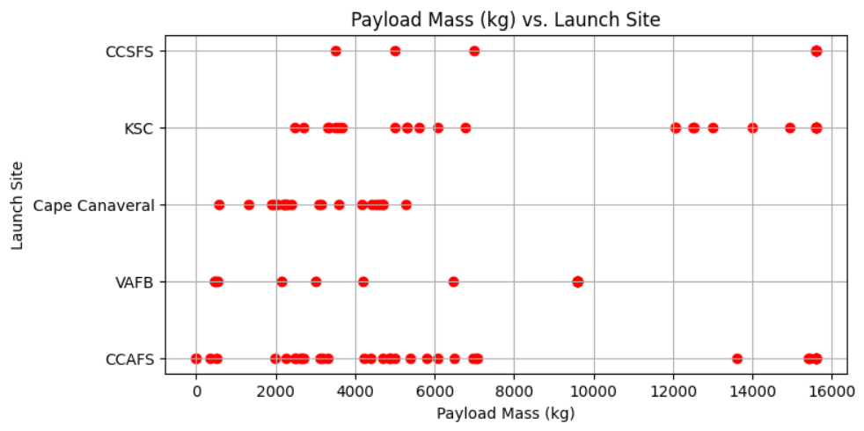
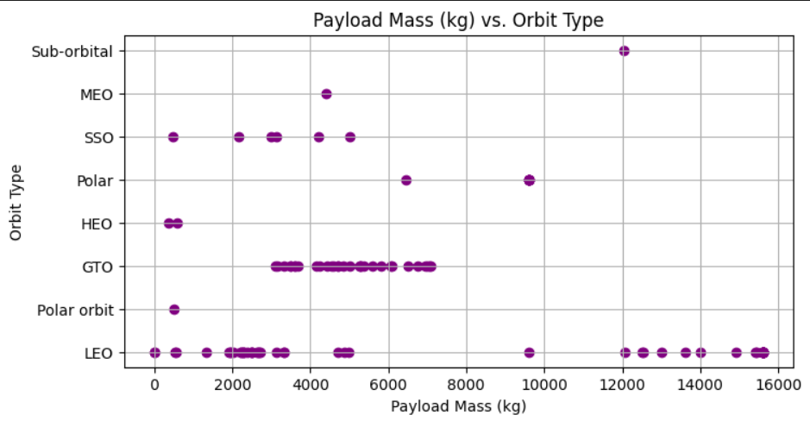
Visualizations:

Slide 9
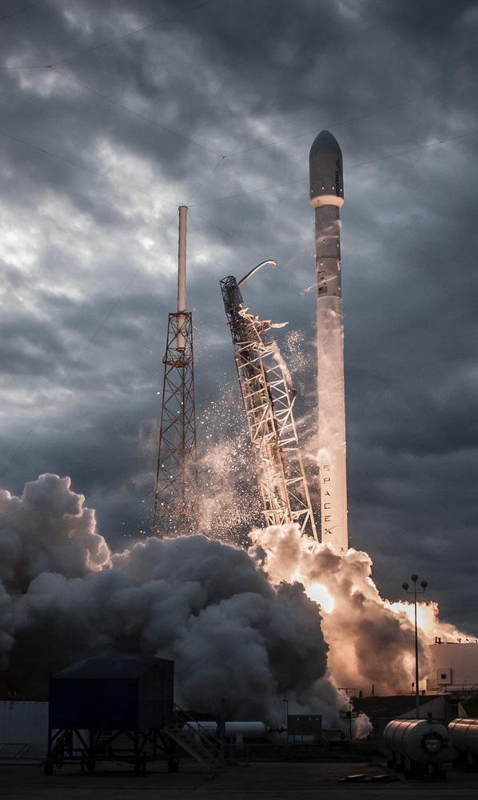
Results Summary
Exploratory Data Analysis:
Launch success has improved over time
KSC LC-39A has the highest success rate among landing sites
Orbits ES-L1, GEO, HEO and SSO have a 100% success rate
Visual Analytics:
Most launch sites are near the equator, and all are close to the coast
Launch sites are far enough away from anything a failed launch can damage
(city, highway, railway), while still close enough to bring people and material
to support launch activities
16

Slide 10
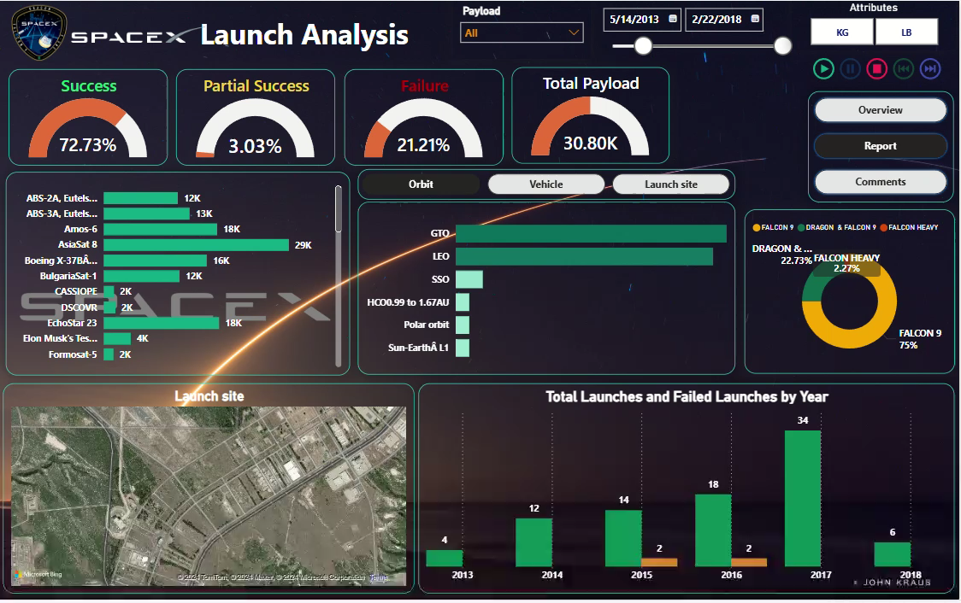
Dashboard: SpaceX Launch Analysis

Slide 11
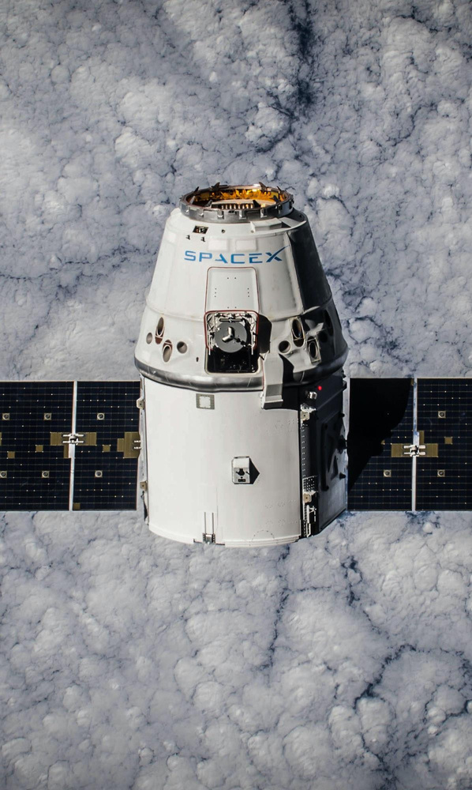
Conclusion
The analysis of the SpaceX launch dataset reveals several key insights:
Growth in Launch Activities:
Significant increase in launches, especially from 2017 onwards.
High Success Rate:
105 out of 106 launches were successful, showcasing reliability.
Key Launch Sites:
Cape Canaveral, Kennedy Space Center, and Vandenberg Air Force Base are the primary launch sites.
Payload and Orbits:
LEO and Polar orbits handle the heaviest payloads.
GTO and SSO are also common destinations.
Booster Landings:
High number of successful landings, supporting reusability goals.
Diverse Customer Base:
NASA is the largest customer, followed by SpaceX's own missions and other entities.
Booster Versions:
Falcon 9 Block 5 is the most frequently used booster.
These insights highlight SpaceX's leadership in the space industry, their commitment to innovation, and their progress towards making space travel more accessible and sustainable.
41

Slide 12
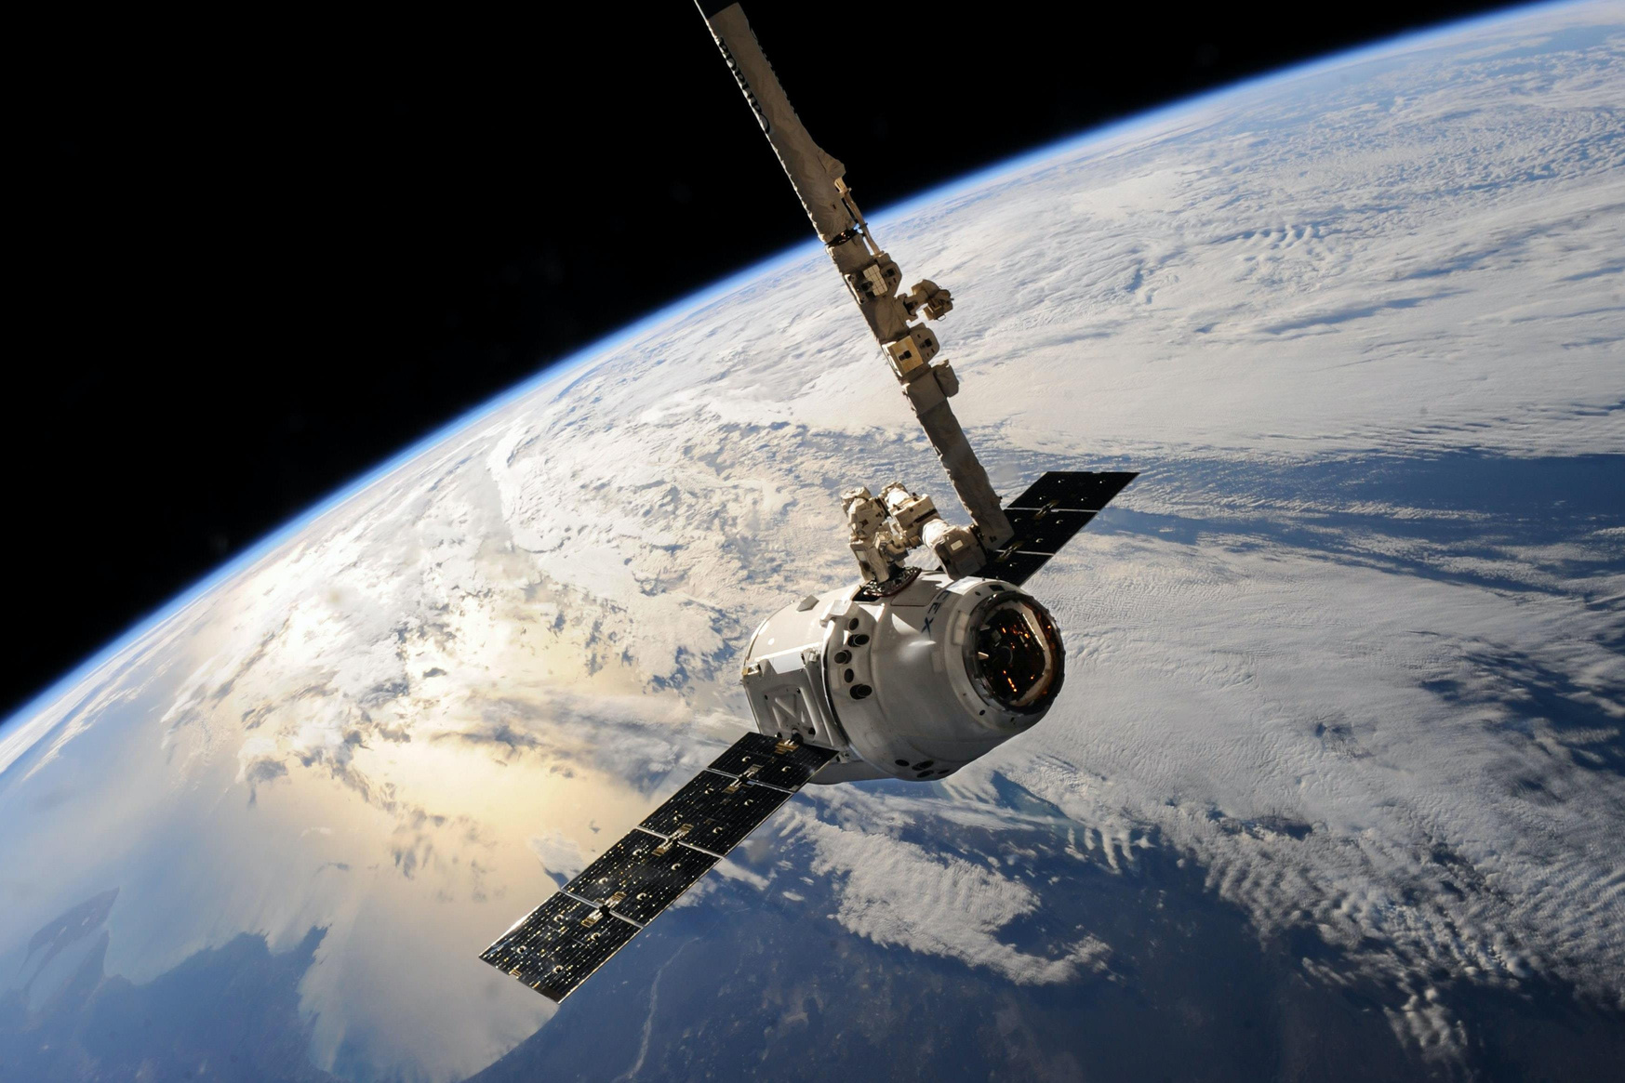
Thank You
Suman Bera
+91-7501823400
sumanberapapai1@gmail.com

